Slide 1
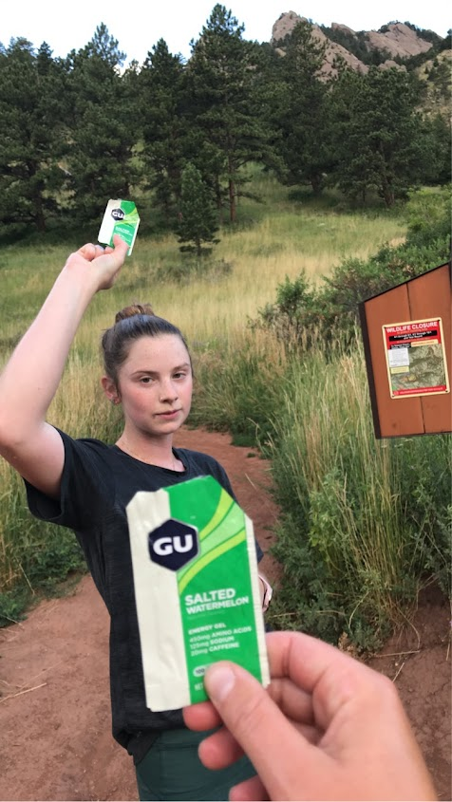

Intro to SLURM
IQ bootcamp 2023

Slide 2
Outline
What is a computing cluster?
What is LMOD and how is it useful?
What is slurm and how can I use it?

Slide 3
Some definitions
Compute cluster – set of computers that work together as a single system
Node – virtual machine (one unit) that is part of a cluster
compute tasks, controlled by a job manager/scheduler (SLURM)
Core – CPU processor (node can have multiple cores)
SLURM – open-source cluster management/job scheduling system for LINUX clusters
CPU – central processing unit
“brain” of computer, knows how to process input, store data, and output results
GPU – graphical processing unit
Like a CPU but can run more tasks concurrently; originally for rendering high-resolution images/video
LMOD – Lua based module system, helps change environment through modulefiles and add/remove directories to the PATH environment variable
CPU: Central Processing Unit | AP CSP (article) | Khan Academy. https://www.khanacademy.org/computing/computers-and-internet/xcae6f4a7ff015e7d:computers/xcae6f4a7ff015e7d:computer-components/a/central-processing-unit-cpu.
CPU vs GPU | Definition and FAQs | HEAVY.AI. https://www.heavy.ai/technical-glossary/cpu-vs-gpu.
"Best practices for the deployment and management of production HPC clusters," R. McLay, K. W. Schulz, W. L. Barth, and T. Minyard, In State of the Practice Reports, SC11, pages 9:1–9:11, Nov. 2011. doi.acm.org/10.1145/2063348.2063360.

Slide 4
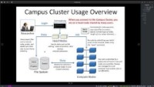

Slide 5
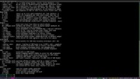

Slide 6
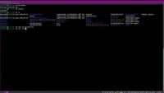

Slide 7
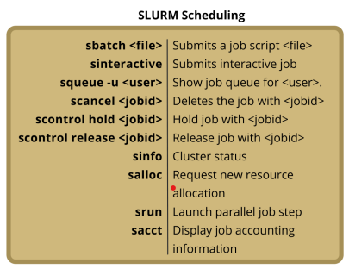
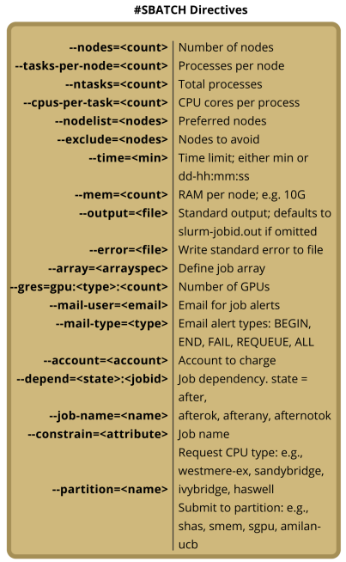
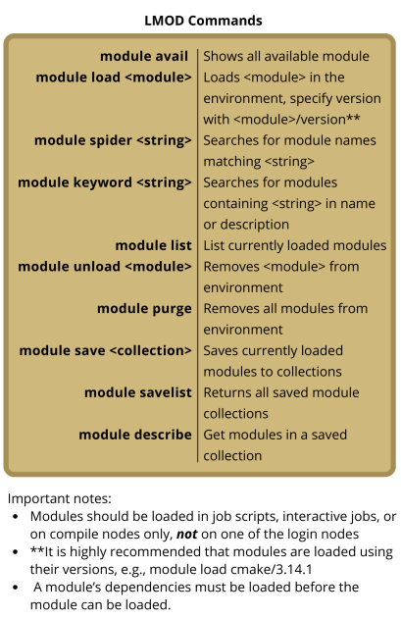
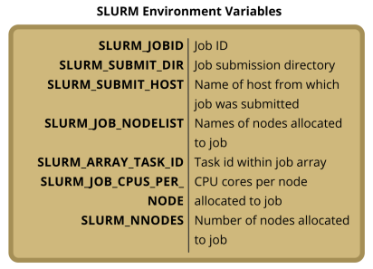
Setting up/executing a script with SLURM

Slide 8
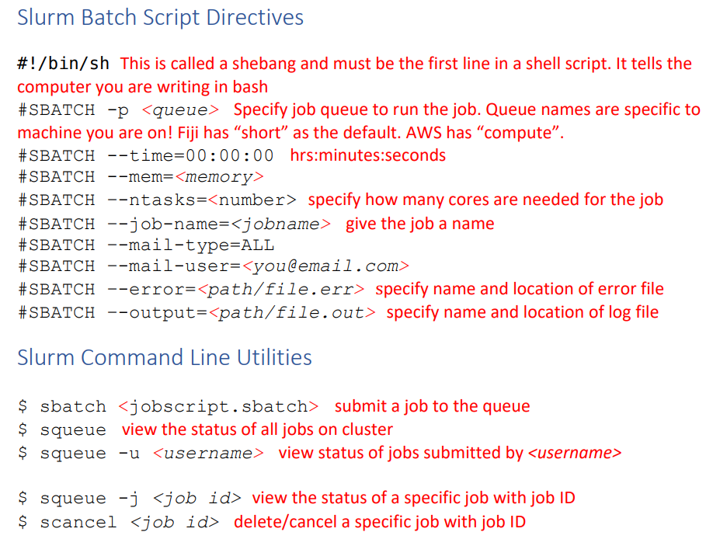
Setting up/executing a script with SLURM
DnA Lab | Short Read Workshop. https://biodatasci.colorado.edu/shortread/sr2023/#day3.

Slide 9
Helpful suggestions: 1) organization 2) optimization
Organization:
input and output directories
Make a template and copy each time you need a new script
Default suggestions: ntasks=1
time=1:00:00
mem=1gb
Optimizing:
Guess, run one file, check what was used (sstat for active jobs or sacct for completed jobs) , adjust script, run the rest of files
DnA Lab | Short Read Workshop. https://biodatasci.colorado.edu/shortread/sr2023/#day3.

Slide 10
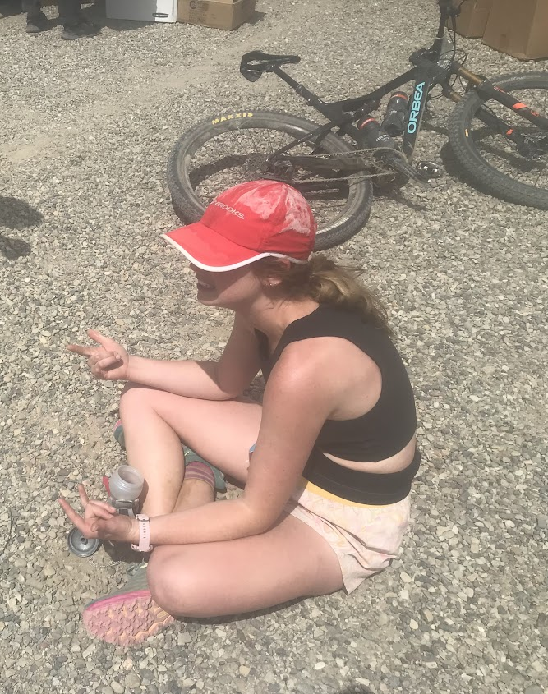
Why do my jobs keep failing?
File path issues
Command line setup
Version compatibility
Job setup/ SLURM headings

Slide 11
Questions and guided practice!

